Slide 1

Robust Medical Diagnosis with Multi-Modal Data
By
Manjari M(2020239010)
Keerthi Raj D(2020242008)
Ranjan Kumar K V(2020242016)

Slide 2
Problem Statement
Given the complex nature of Covid-19, which manifests with a wide range of symptoms and radiographic abnormalities, an effective diagnostic tool must integrate information from multiple sources to enhance prediction accuracy and support early intervention.
It aims to address the challenge of Covid-19 diagnosis by developing a multi-modal diagnostic model that leverages both medical imaging and textual clinical data.

Slide 3
Objective
To build a reliable diagnostic system for detecting Covid-19 by combining the complementary strengths of imaging data and textual patient information.
This system helps healthcare professionals detect Covid-19 more efficiently, especially in areas with limited resources where labeled data for one type of medical data (like images or text) is scarce

Slide 4
Multi Modal Medical Diagnosis
The provided code implements a multi-modal diagnostic system for detecting COVID-19 using both medical images (e.g., CT or MRI scans) and patient clinical notes. The system leverages deep learning-based feature extraction models to process multi-modal data inputs.

Slide 5
Image Extraction(CNN)
The code implements a Convolutional Neural Network (CNN) and utilizes the ResNet architecture for predicting lung diseases, specifically COVID-19. Here’s a detailed explanation of how CNN and ResNet are incorporated:
1. CNN Base Framework:
The code uses convolutional layers to extract spatial features from the input images (e.g., chest X-rays or CT scans).Layers like Conv2D, ReLU activation, and Pooling help the model focus on relevant visual features (e.g., patterns indicating infection or lung damage).

Slide 6
Image Extraction
2. Feature Extraction:
The CNN processes image data, extracting hierarchical features such as edges, textures, and more complex structures.
3. Classification Layer:
After feature extraction, fully connected layers (or dense layers) are applied to perform classification.

Slide 7
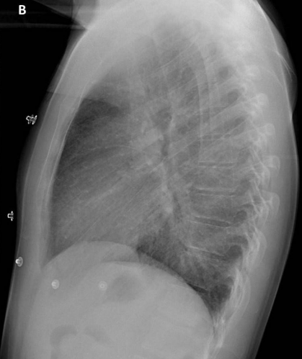
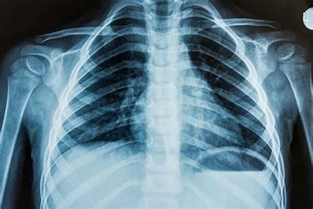
Image(MRI of Lungs)

Slide 8
ResNet Integration in the code
ResNet (Residual Network) enhances traditional CNNs with residual connections to solve the problem of vanishing gradients and improve training efficiency, especially for deep networks.
The code appears to use a pre-trained ResNet model (e.g., ResNet-50 or ResNet-101) as the backbone.

Slide 9
ResNet Integration in the code
ResNet-50 architecture, which is a 50-layer deep convolutional neural network. It is a well-known model used for image classification tasks and is a part of the PyTorch model library (torchvision.models).
This argument(pretrained=True) specifies that the model should be initialized with weights pre-trained on a large dataset (usually ImageNet, which consists of millions of labeled images across 1,000 categories). By using pretrained=True, you are leveraging knowledge that the network has already gained through this training process.

Slide 10
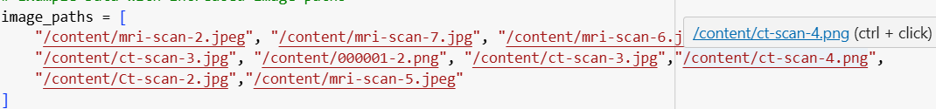
Image Inputs

Slide 11
Why this approach used?
Transfer Learning: By using a pre-trained ResNet model, the code benefits from a network already trained on millions of images. This is crucial for medical applications with relatively small datasets.
Deep Feature Learning : CNNs and ResNet are highly effective in capturing intricate patterns in medical imaging, such as lung abnormalities caused by COVID-19.

Slide 12
Text Extraction(Transformer-BERT)
BERT (Bidirectional Encoder Representations from Transformers) is a transformer-based model developed by Google for natural language processing (NLP). Unlike previous models (like RNNs or LSTMs), which processed input text sequentially, transformers work with self-attention mechanisms that allow them to consider the entire context of the input at once, enabling more effective language understanding.

Slide 13
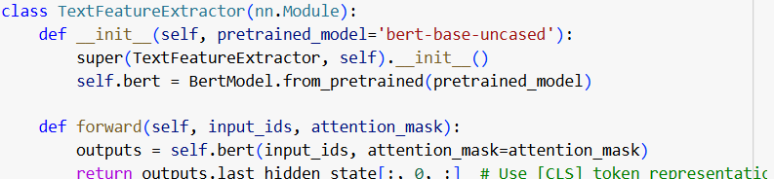
BERT Integration in the code
BertModel.from_pretrained(pretrained_model='bert-base-uncased') loads a pre-trained BERT model.
In this case, it uses the
"bert-base-uncased" variant, which means:"bert-base" refers to a smaller BERT model with 12 layers, 768 hidden units, and 110M parameters.
"uncased" indicates that the model was trained on lower-cased text, meaning it doesn't distinguish between uppercase and lowercase letters.

Slide 14
BERT Integration in the code
The pre-trained model has already been trained on large corpora like Wikipedia and BookCorpus. This gives the model a strong understanding of general language patterns, but it can be fine-tuned on a specific dataset for a particular task
input_ids: These are the tokenized words of the input text, where each word or subword is converted into a corresponding ID based on the vocabulary.
attention_mask: This is used to indicate which tokens are actual data (1) and which are padding (0). It allows BERT to ignore padded tokens during the self-attention mechanism

Slide 15
BERT Integration in the code
The outputs from BERT consist of several things, but the most important one here is last_hidden_state, which contains the embeddings for each token in the input text.
BERT processes the input sequence and outputs a contextualized representation of each token based on the surrounding context

Slide 16
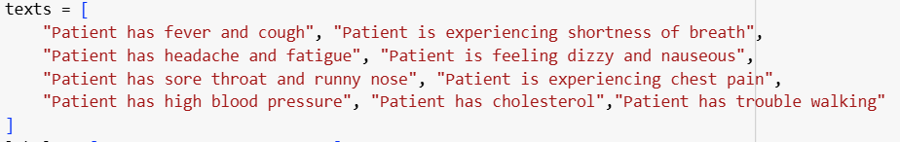
Text Inputs

Slide 17
Why use BERT?
Bidirectionality: Traditional language models process text from left to right or right to left, but BERT reads text in both directions simultaneously, which allows it to capture the full context of each word in a sentence.
Tokenization: Before feeding text into BERT, it needs to be tokenized into sub words using a tokenizer (often the WordPiece tokenizer). BERT uses the special [CLS] token at the start and [SEP] token to separate sentences for tasks like classification.
Self-Attention Mechanism: The key idea behind transformers is the self-attention mechanism, which assigns a weight to each word in a sentence based on its relevance to the other words. This allows the model to focus on important relationships in the text

Slide 18
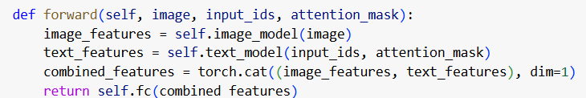
How it integrates into the Multi-Modal
By combining the BERT-based text feature extractor with the image features from ResNet, the output of BERT serves as a fixed-length feature vector representing the meaning of the input text. This is concatenated with the image features, and the combined feature vector is passed through a fully connected layer to perform the final classification.

Slide 19
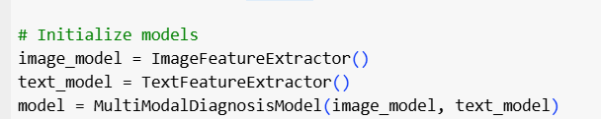
Function calling of Multi-modal

Slide 20
Model Training(Adam optimizer)
The Adam optimizer (torch.optim.Adam) is one of the most popular optimization algorithms used in deep learning due to its efficiency and adaptability. It combines the advantages of two other extensions of stochastic gradient descent (SGD)

Slide 21
Model Training(Adam optimizer)
model.parameters(): This refers to the model parameters (weights and biases) that need to be updated during training.
lr=0.0001: This is the learning rate for the optimizer, controlling the size of the steps the optimizer takes towards minimizing the loss function. A smaller learning rate generally leads to more precise convergence but requires more training steps

Slide 22

Model Training(CrossEntropy Loss function)
The nn.CrossEntropyLoss() function computes the loss used for multi-class classification problems.
This loss function is typically used for tasks like image classification, text classification, and other problems where each sample belongs to one of several classes

Slide 23
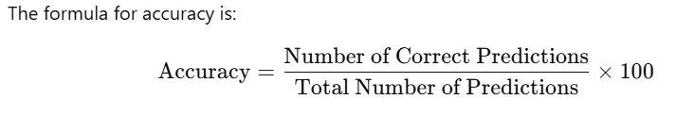
Accuracy
It measures the percentage of correct predictions made by the model, i.e., how many times the model's predicted class matches the true class

Slide 24
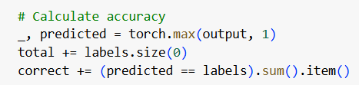
Accuracy in the code
torch.max(output, 1) retrieves the predicted class (the class with the highest probability). By comparing these predictions with the actual labels, you can calculate the overall accuracy of the model for the current epoch.
accuracy = correct / total *100

Slide 25
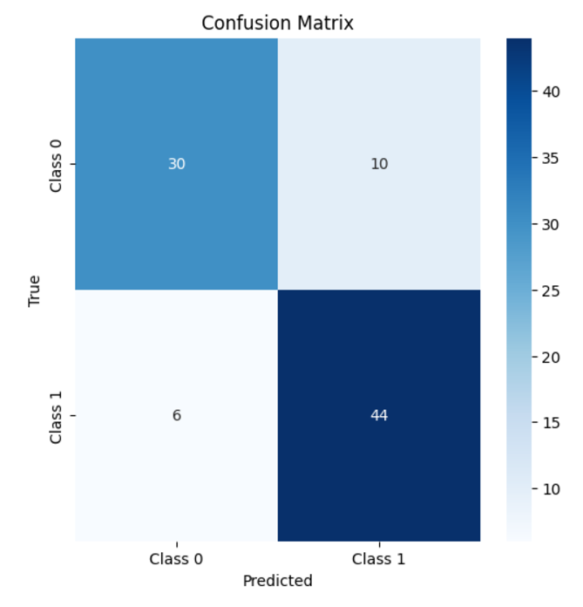
Conclusion
The overall accuracy of the modal is 82.22%
Class 0 (Non-Corona/Healthy):
True Positives (30): Correctly predicted non-corona cases.
False Negatives (10): Cases that were corona-positive but were misclassified as non-corona.
Class 1 (Corona):
True Positives (44): Correctly predicted corona-positive cases.
False Negatives (6): Cases that were non-corona but were misclassified as corona-positive.

Slide 26
References
[2203.15588] Deep Multi-modal Fusion of Image and Non-image Data in Disease Diagnosis and Prognosis: A Review
Deep multimodal fusion of image and non-image data in disease diagnosis and prognosis: a review
Residual Networks (ResNet) - Deep Learning – GeeksforGeeks
PyTorch

Slide 27
Thank you

